Slide 1
Heterogeneous Computing: New Directions for Efficient and Scalable High-Performance Computing
CSCE 791
Dr. Jason D. Bakos

Slide 2
Minimum Feature Size
Year | Processor | Speed | Transistors | Process
1982 | i286 | 6 - 25 MHz | ~134,000 | 1.5 μm
1986 | i386 | 16 – 40 MHz | ~270,000 | 1 μm
1989 | i486 | 16 - 133 MHz | ~1 million | .8 μm
1993 | Pentium | 60 - 300 MHz | ~3 million | .6 μm
1995 | Pentium Pro | 150 - 200 MHz | ~4 million | .5 μm
1997 | Pentium II | 233 - 450 MHz | ~5 million | .35 μm
1999 | Pentium III | 450 – 1400 MHz | ~10 million | .25 μm
2000 | Pentium 4 | 1.3 – 3.8 GHz | ~50 million | .18 μm
2005 | Pentium D | 2 cores/package | ~200 million | .09 μm
2006 | Core 2 | 2 cores/die | ~300 million | .065 μm
2008 | Core i7 | 4 cores/die 8 threads/die | ~800 million | .045 μm
2010 | “Sandy Bridge” | 8 cores/die 16 threads/die?? | ?? | .032 μm

Slide 3
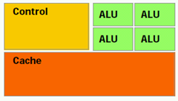
Computer Architecture Trends
Multi-core architecture:
Individual cores are large and heavyweight, designed to force performance out of generalized code
Programmer utilizes multi-core using OpenMP
CPU
L2 Cache (~50% chip)
Memory

Slide 4
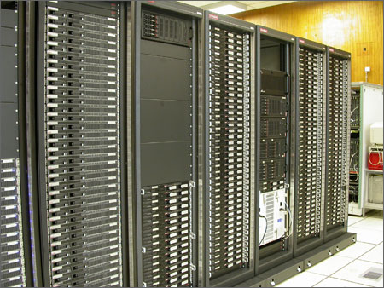
“Traditional” Parallel/Multi-Processing
Large-scale parallel platforms:
Individual computers connected with a high-speed interconnect
Upper bound for speedup is n, where n = # processors
How much parallelism in program?
System, network overheads?

Slide 5
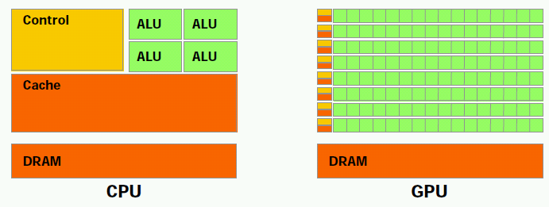
Co-Processors
Special-purpose (not general) processor
Accelerates CPU

Slide 6
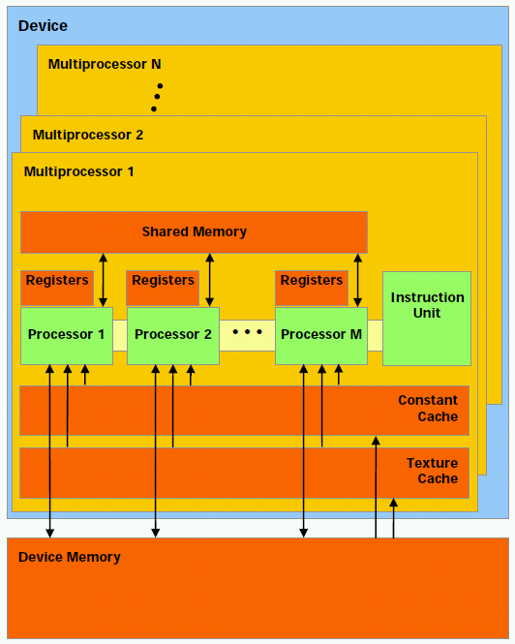
NVIDIA GT200 GPU Architecture
240 on-chip processor cores
Simple cores:
In-order execution, no branch prediction, spec. execution, multiple issue
No support for context switches, OS, activation stack, dynamic memory
No r/w cache (just 16K programmer-managed on-chip memory)
Threads must be comprised on identical code, must all behave the same w.r.t. if-statements and loops

Slide 7
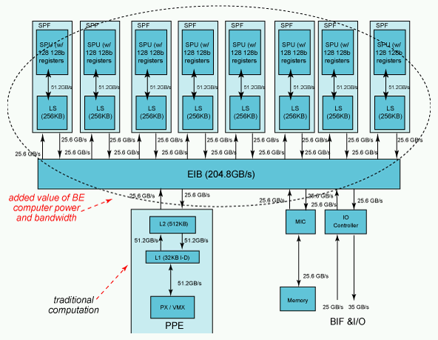
IBM Cell/B.E. Architecture
1 PPE, 8 SPEs
Programmer must manually manage 256K memory and threads invocation on each SPE
Each SPE includes a vector unit like the one on current Intel processors
128 bits wide

Slide 8
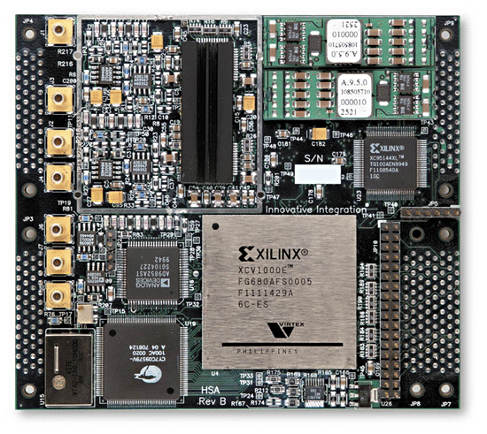
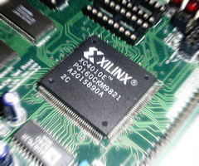
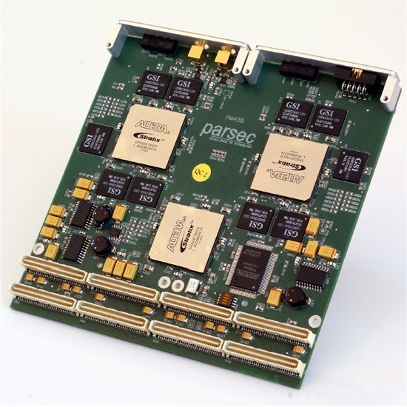
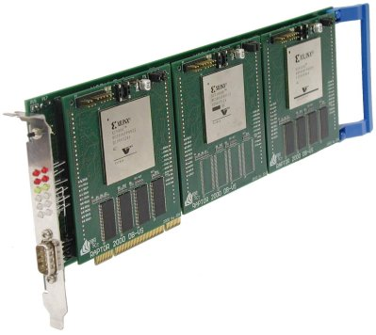
High-Performance Reconfigurable Computing
Heterogeneous computing with reconfigurable logic, i.e. FPGAs

Slide 9
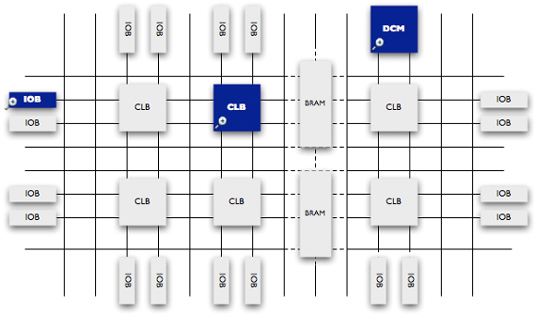
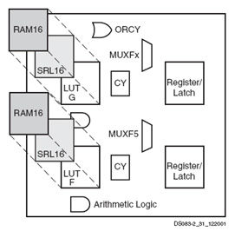
Field-Programmable Gate Array

Slide 10
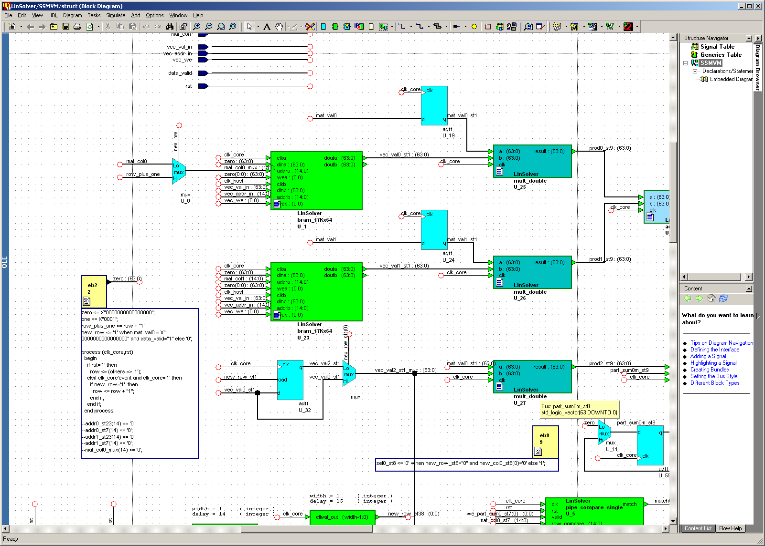
Programming FPGAs

Slide 11
HC Execution Model
Host Memory
CPU
QPI
PCIe
On board
Memory
X58
Co-processor
~25 GB/s
~25 GB/s
~8 GB/s (x16)
?????
~100 GB/s for GeForce 260
host
add-in card

Slide 12
Heterogeneous Computing
Example:
Application requires a week of CPU time
Offload computation consumes 99% of execution time
49% of code
initialization
0.5% of run time
“hot” loop
99% of run time
1% of code
Kernel speedup | Application speedup | Execution time
50 | 34 | 5.0 hours
100 | 50 | 3.3 hours
200 | 67 | 2.5 hours
500 | 83 | 2.0 hours
1000 | 91 | 1.8 hours
49% of code
clean up
0.5% of run time
co-processor

Slide 13
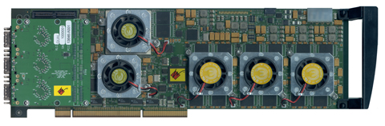
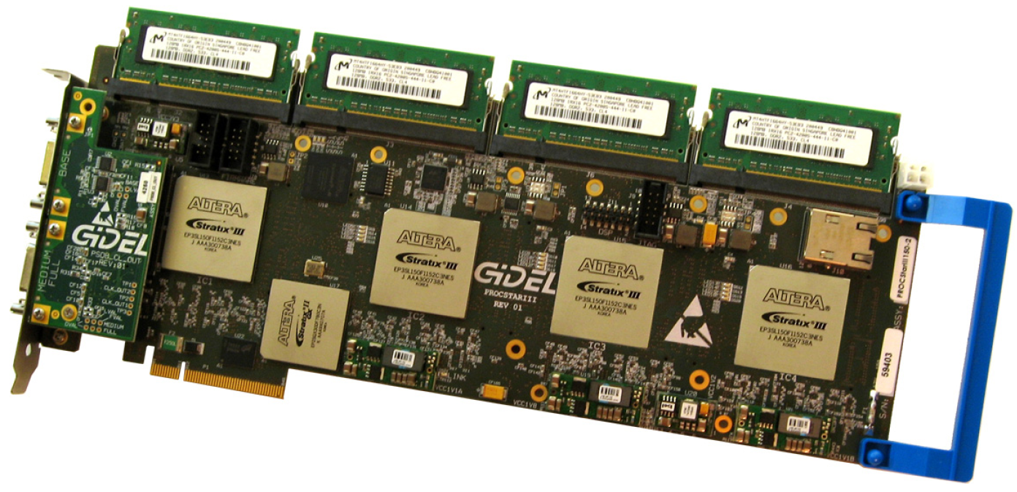
Heterogeneous Computing with FPGAs
Annapolis Micro Systems
WILDSTAR 2 PRO
GiDEL PROCSTAR III

Slide 14
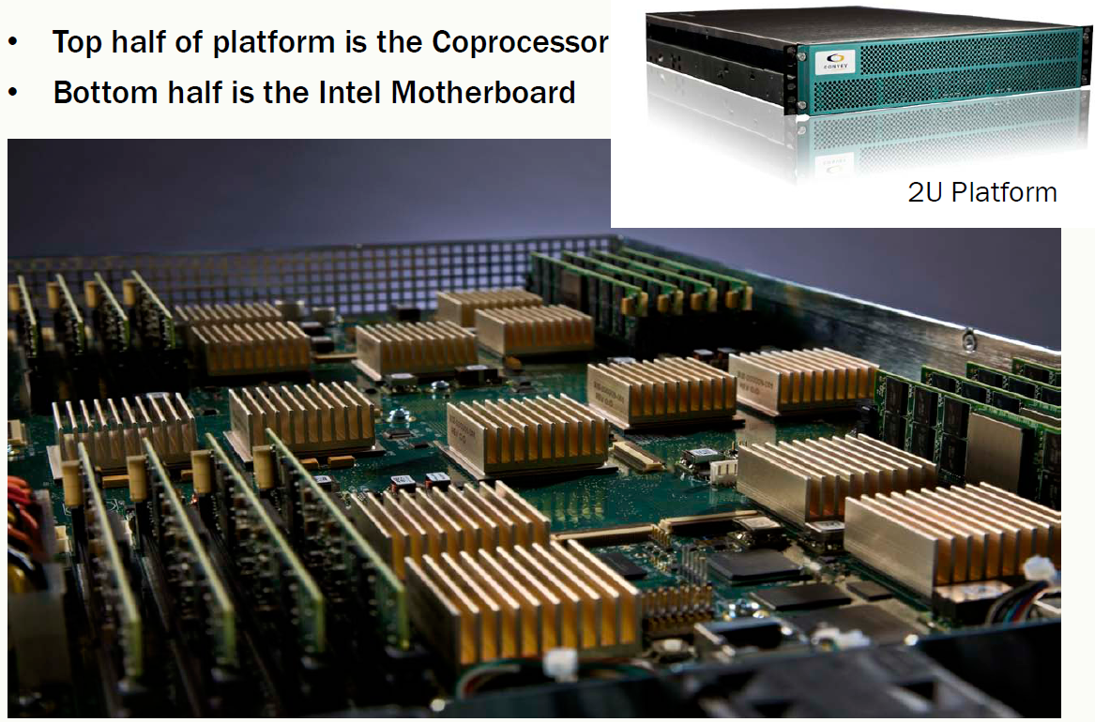
Heterogeneous Computing with FPGAs
Convey HC-1

Slide 15
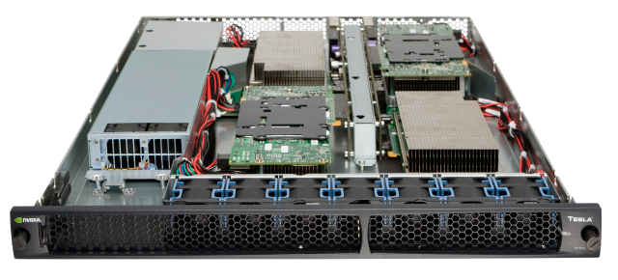
Heterogeneous Computing with GPUs
NVIDIA Tesla S1070

Slide 16
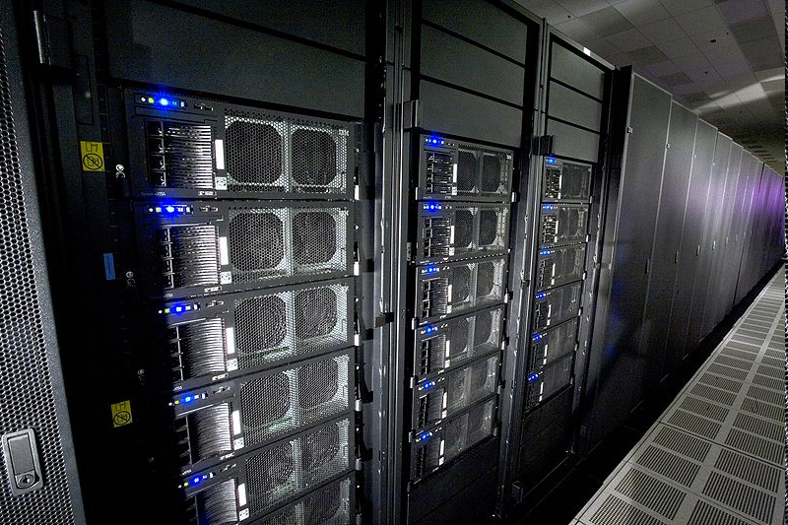
Heterogeneous Computing now Mainstream: IBM Roadrunner
Los Alamos, second fastest computer in the world
6,480 AMD Opteron (dual core) CPUs
12,960 PowerXCell 8i GPUs
Each blade contains 2 Operons and 4 Cells
296 racks
First ever petaflop machine (2008)
1.71 petaflops peak (1.7 billion million fp operations per second)
2.35 MW (not including cooling)
Lake Murray hydroelectric plant produces ~150 MW (peak)
Lake Murray coal plant (McMeekin Station) produces ~300 MW (peak)
Catawba Nuclear Station near Rock Hill produces 2258 MW

Slide 17
Our Group: HeRC
Applications work
Computational phylogenetics (FPGA/GPU)
GRAPPA and MrBayes
Sparse linear algebra (FPGA/GPU)
Matrix-vector multiply, double-precision accumulators
Data mining (FPGA/GPU)
Logic minimization (GPU)
System architecture
Multi-FPGA interconnects
Tools
Automatic partitioning (PATHS)
Micro-architectural simulation for code tuning

Slide 18
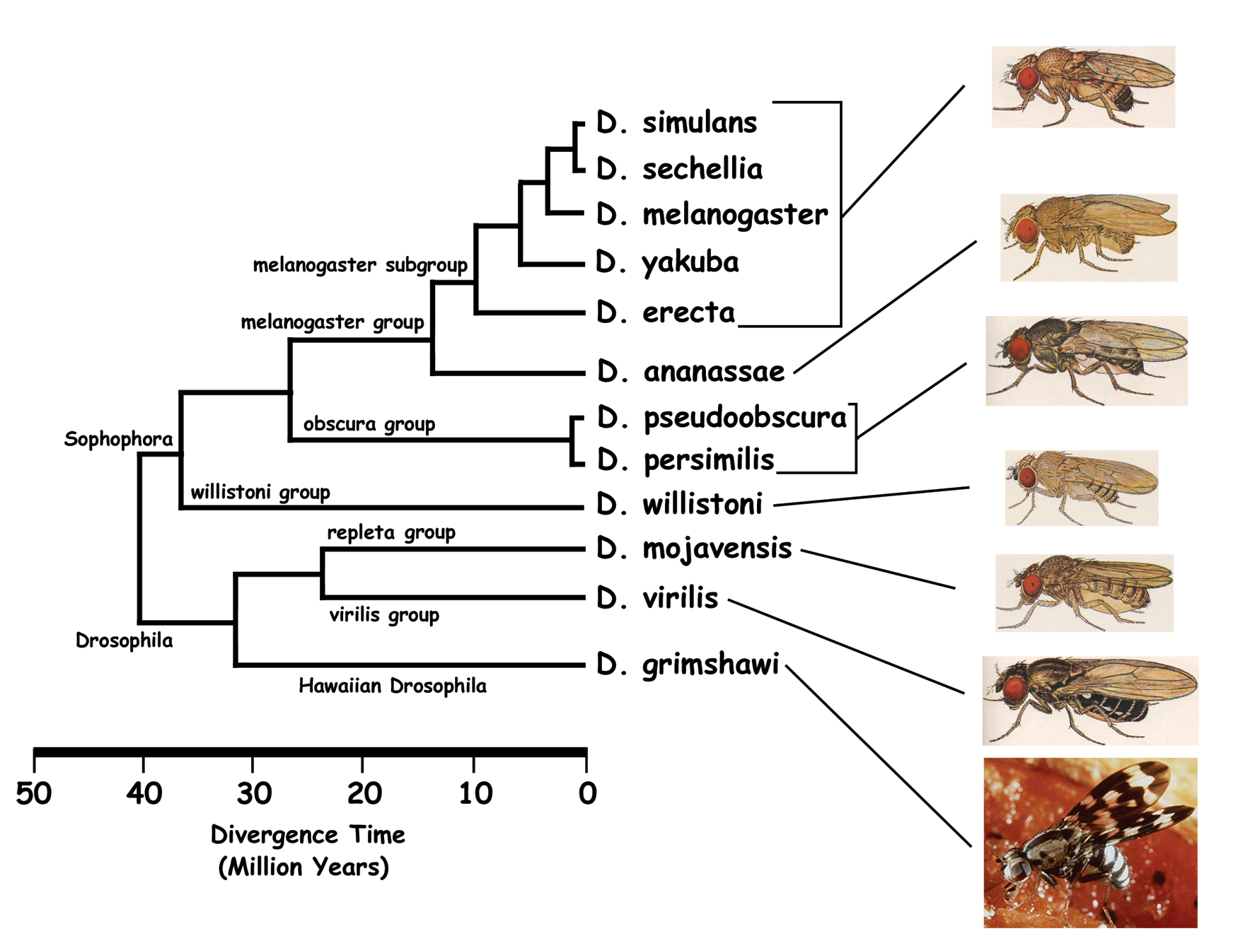
Phylogenies
genus Drosophila

Slide 19
Custom Accelerators for Phylogenetics
g3
g1
g4
g2
g1
g3
g2
g5
g5
g5
g6
g4
g6
Unrooted binary tree
n leaf vertices
n - 2 internal vertices (degree 3)
Tree configurations =
(2n - 5) * (2n - 7) * (2n - 9) * … * 3
200 trillion trees for 16 leaves
g6
g3
g5
g2
g1
g4
g5

Slide 20
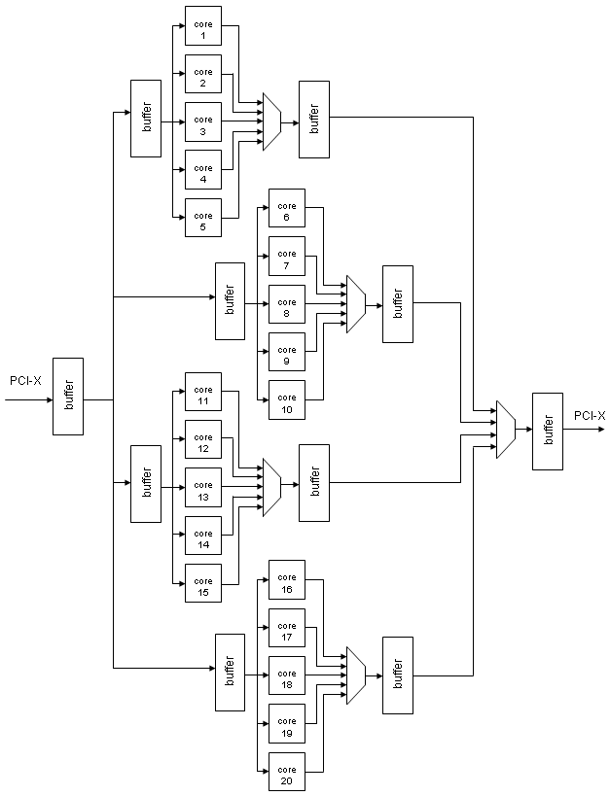
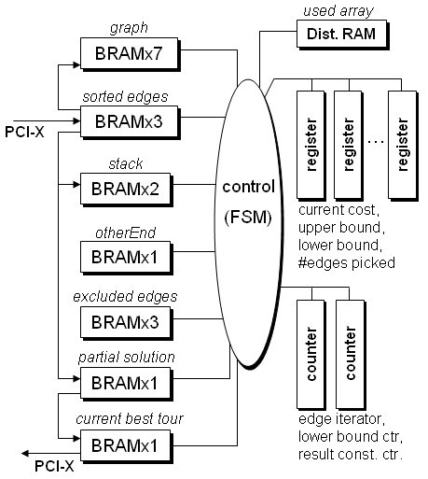
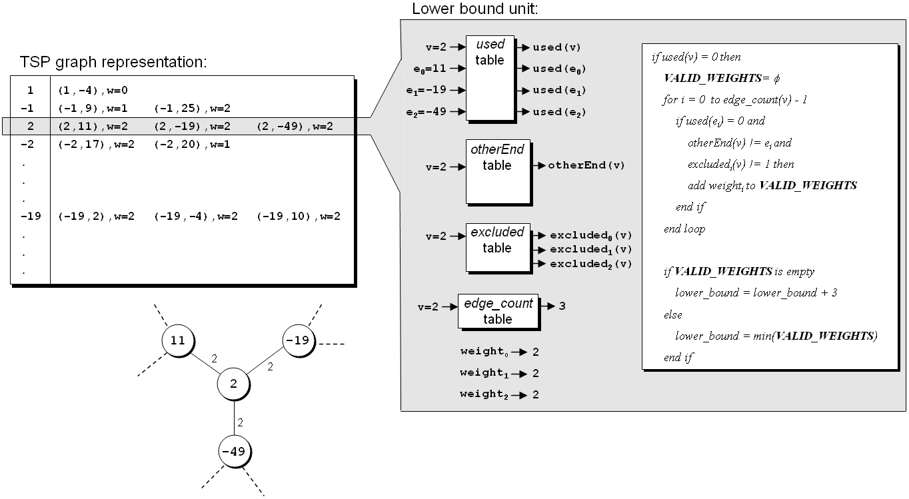
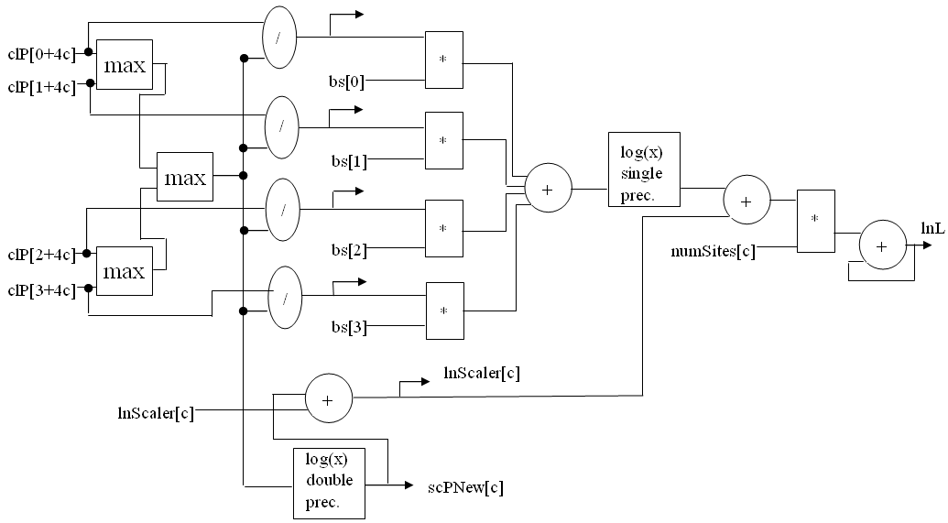
Our Projects
FPGA-based co-processors for computational biology
1000X speedup!
Tiffany M. Mintz, Jason D. Bakos, "A Cluster-on-a-Chip Architecture for High-Throughput Phylogeny Search," IEEE Trans. on Parallel and Distributed Systems, in press.
Stephanie Zierke, Jason D. Bakos, "FPGA Acceleration of Bayesian Phylogenetic Inference," BMC Bioinformatics, in press.
Jason D. Bakos, Panormitis E. Elenis, "A Special-Purpose Architecture for Solving the Breakpoint Median Problem," IEEE Transactions on Very Large Scale Integration (VLSI) Systems, Vol. 16, No. 12, Dec. 2008.
Jason D. Bakos, Panormitis E. Elenis, Jijun Tang, "FPGA Acceleration of Phylogeny Reconstruction for Whole Genome Data," 7th IEEE International Symposium on Bioinformatics & Bioengineering (BIBE'07), Boston, MA, Oct. 14-17, 2007.
Jason D. Bakos, “FPGA Acceleration of Gene Rearrangement Analysis,” 15th Annual IEEE International Symposium on Field-Programmable Custom Computing Machines (FCCM'07), April 23-25, 2007.
10X speedup!

Slide 21
Double Precision Accumulation
FPGAs allow data to be “streamed” into a computational pipeline
Many kernels targeted for acceleration include
Such as: dot product, used for MVM: kernel for many methods
For large datasets, values delivered serially to an accumulator
Reduction operation
Σ
G+H+I,
set 3
D+E+F,
set 2
A+B+C,
set 1
I,
set 3
H,
set 3
G,
set 3
F,
set 2
E,
set 2
D,
set 2
C,
set 1
B,
set 1
A,
set 1

Slide 22
The Reduction Problem
Basic Accumulator Architecture
Feedback Loop
+
Adder Pipeline
Partial sums
Reduction Ckt
Control
Required Design
Mem
Mem

Slide 23
Approach
Reduction complexity scales with the latency of the core operation
Reduce latency of double precision add?
IEEE 754 adder pipeline (assume 4-bit significand):
Compare exponents
De-normalize smaller value
Add 53-bit mantissas
Round
Re-normalize
Round
1.1011 x 2²³
1.1110 x 2²¹
1.1011 x 2²³
0.01111 x 2²³
10.00101 x 2²³
10.0011 x 2²³
1.00011 x 2²⁴
1.0010 x 2²⁴

Slide 24
Base Conversion
Previous work in s.p. MAC designs base conversion
Idea:
Shift both inputs to the left by amout specified in low-order bits of exponents
Reduces size of exponent, requires wider adder
Example:
Base-8 conversion:
1.01011101, exp=10110 (1.36328125 x 2²² => ~5.7 million)
Shift to the left by 6 bits…
1010111.01, exp=10 (87.25 x 2^{8*2} = > ~5.7 million)

Slide 25
Exponent Compare vs. Adder Width
Base | Exponent Width | Denormalize speed | Adder Width | #DSP48s
16 | 7 | 119 MHz | 54 | 2
32 | 6 | 246 MHz | 86 | 2
64 | 5 | 368 MHz | 118 | 3
128 | 4 | 372 MHz | 182 | 4
256 | 3 | 494 MHz | 310 | 7
denorm
DSP48
DSP48
DSP48
renorm

Slide 26
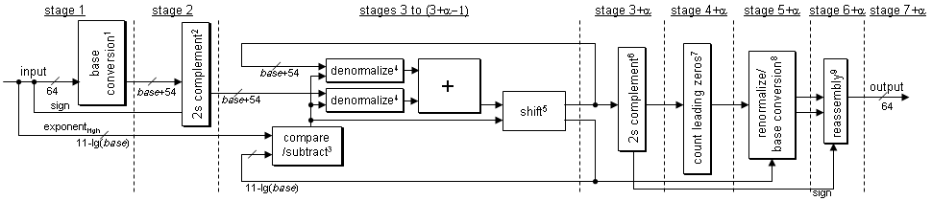
Accumulator Design

Slide 27
Accumulator Design
stage 1
stage 2
stages 3 to (3+α−1)
stage 3+α
stage 4+α
stage 5+α
stage 6+α
stage 7+α
input
base conversion
2s complement
base+54
denormalize
+
output
64
base+54
base+54
denormalize
2s complement
renormalize/
base conversion
reassembly
sign
shift
count leading zeros
64
exponent_{high}
compare
/subtract
11-lg(base)
11-lg(base)
sign
Preprocess
Post-process
Feedback Loop
α= 3

Slide 28
Three-Stage Reduction Architecture
Input
Output
buffer
“Adder” pipeline
Input
buffer

Slide 29
Three-Stage Reduction Architecture
Input
Output
buffer
“Adder” pipeline
B1
α3
α2
α1
0
Input
buffer

Slide 30
Three-Stage Reduction Architecture
Input
Output
buffer
“Adder” pipeline
B2
B1
α3
α2
α1
Input
buffer

Slide 31
Three-Stage Reduction Architecture
Input
Output
buffer
“Adder” pipeline
B3
α1+α2
B1
α3
Input
buffer
B2

Slide 32
Three-Stage Reduction Architecture
Input
Output
buffer
“Adder” pipeline
B4
B2+B3
α1+α2
B1
α3
Input
buffer

Slide 33
Three-Stage Reduction Architecture
Input
Output
buffer
“Adder” pipeline
B5
B1+B4
B2+B3
α1+α2
α3
Input
buffer

Slide 34
Three-Stage Reduction Architecture
Input
Output
buffer
“Adder” pipeline
B6
α1+α2+α3
B1+B4
B2+B3
Input
buffer
B5

Slide 35
Three-Stage Reduction Architecture
Input
Output
buffer
“Adder” pipeline
B7
B2+B3+B6
α1+α2+α3
B1+B4
Input
buffer
B5

Slide 36
Three-Stage Reduction Architecture
Input
Output
buffer
“Adder” pipeline
B8
B1+B4+B7
B2+B3+B6
α1+α2+α3
Input
buffer
B5

Slide 37
Three-Stage Reduction Architecture
Input
Output
buffer
“Adder” pipeline
C1
B5+B8
B1+B4+B7
B2+B3+B6
0
Input
buffer

Slide 38
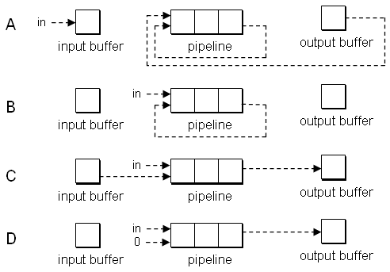
Minimum Set Size
Four “configurations”:
Deterministic control sequence, triggered by set change:
D, A, C, B, A, B, B, C, B/D
Minimum set size is 8

Slide 39
Use Case: Sparse Matrix-Vector Multiply
0
1
2
3
4
5
6
7
8
9
10
A
0
0
0
B
0
val
A
B
C
D
E
F
G
H
I
J
K
0
0
0
C
0
D
E
0
0
0
F
G
col
0
4
3
5
0
4
5
0
2
4
3
H
0
0
0
0
0
0
0
I
0
J
0
ptr
0
2
4
7
8
10
11
0
0
0
K
0
0
Group vol/col
Zero-terminate
(A,0) (B,4) (0,0) (C,3) (D,4) (0,0)…

Slide 40
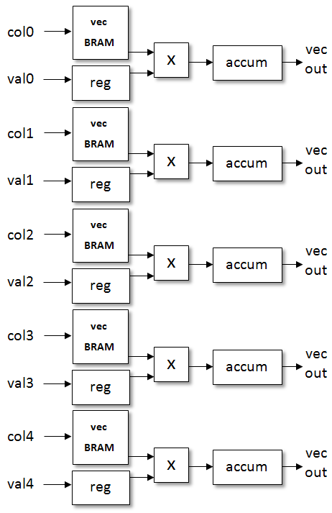
New SpMV Architecture
Delete tree, replicate accumulator, schedule matrix data:
400 bits
val_{0,0} | col_{0,0} | val_{1,0} | col_{1,0} | val_{2,0} | col_{2,0} | val_{3,0} | col_{3,0} | val_{4,0} | col_{4,0}
val_{0,1} | col_{0,1} | val_{1,1} | col_{1,1} | val_{2,1} | col_{2,1} | val_{3,1} | col_{3,1} | val_{4,1} | col_{4,1}
val_{0,2} | col_{0,2} | val_{1,2} | col_{1,2} | val_{2,2} | col_{2,2} | val_{3,2} | col_{3,2} | val_{4,2} | col_{4,2}
val_{0,3} | col_{0,3} | val_{1,3} | col_{1,3} | val_{2,3} | col_{2,3} | val_{3,3} | col_{3,3} | val_{4,3} | col_{4,3}
val_{0,4} | col_{0,4} | val_{1,4} | col_{1,4} | val_{2,4} | col_{2,4} | val_{3,4} | col_{3,4} | val_{4,4} | col_{4,4}
val_{0,5} | col_{0,5} | val_{1,5} | col_{1,5} | val_{2,5} | col_{2,5} | val_{3,5} | col_{3,5} | val_{4,5} | col_{4,5}
val_{0,6} | col_{0,6} | 0.0 | 0.0 | val_{2,6} | col_{2,6} | val_{3,6} | col_{3,6} | val_{4,6} | col_{4,6}
val_{0,7} | col_{0,7} | 0.0 | 5 | val_{2,7} | col_{2,7} | val_{3,7} | col_{3,7} | val_{4,7} | col_{4,7}
val_{0,8} | col_{0,8} | val_{5,0} | col_{5,0} | val_{2,8} | col_{2,8} | val_{3,8} | col_{3,8} | val_{4,8} | col_{4,8}

Slide 41
Performance Figures
 |  |  |  | GPU |  | FPGA
Matrix | Order/ dimensions | n_{z} | Avg. n_{z}/row | Mem. BW (GB/s) | GFLOPs | GFLOPs (8.5 GB/s)
TSOPF_RS_b162_c3 | 15374 | 610299 | 40 | 58.00 | 10.08 | 1.60
E40r1000 | 17281 | 553562 | 32 | 57.03 | 8.76 | 1.65
Simon/olafu | 16146 | 1015156 | 32 | 52.58 | 8.52 | 1.67
Garon/garon2 | 13535 | 373235 | 29 | 49.16 | 7.18 | 1.64
Mallya/lhr11c | 10964 | 233741 | 21 | 40.23 | 5.10 | 1.49
Hollinger/mark3jac020sc | 9129 | 52883 | 6 | 26.64 | 1.58 | 1.10
Bai/dw8192 | 8192 | 41746 | 5 | 25.68 | 1.28 | 1.08
YCheng/psse1 | 14318 x 11028 | 57376 | 4 | 27.66 | 1.24 | 0.85
GHS_indef/ncvxqp1 | 12111 | 73963 | 3 | 27.08 | 0.98 | 1.13

Slide 42
Performance Comparison
If FPGA Memory bandwidth scaled by adding multipliers/ accumulators to match GPU Memory Bandwidth for each matrix separately
GPU Mem. BW (GB/s) | FPGA Mem BW (GB/s)
58.00 | 51.0 GB/s (x6)
57.03 | 51.0 GB/s (x6)
52.58 | 51.0 GB/s (x6)
49.16 | 42.5 GB/s (x5)
40.23 | 34 GB/s (x4)
26.64 | 25.5 GB/s (x3)
25.68 | 25.5 GB/s (x3)
27.66 | 25.5 GB/s (x3)
27.08 | 25.5 GB/s (x3)

Slide 43
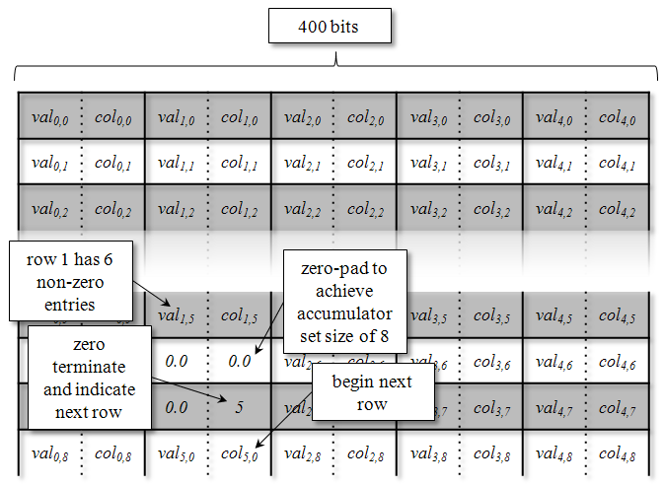
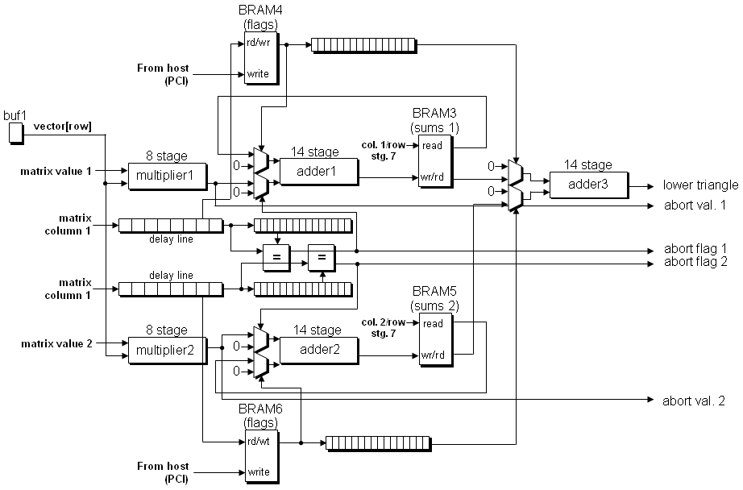
Our Projects
FPGA-based co-processors for linear algebra
Krishna.K. Nagar, Jason D. Bakos, "A High-Performance Double Precision Accumulator," IEEE International Conference on Field-Programmable Technology (IC-FPT'09), Dec. 9-11, 2009.
Yan Zhang, Yasser Shalabi, Rishabh Jain, Krishna K. Nagar, Jason D. Bakos, "FPGA vs. GPU for Sparse Matrix Vector Multiply," IEEE International Conference on Field-Programmable Technology (IC-FPT'09), Dec. 9-11, 2009.
Krishna K. Nagar, Yan Zhang, Jason D. Bakos, "An Integrated Reduction Technique for a Double Precision Accumulator," Proc. Third International Workshop on High-Performance Reconfigurable Computing Technology and Applications (HPRCTA'09), held in conjunction with Supercomputing 2009 (SC'09), Nov. 15, 2009.
Jason D. Bakos, Krishna K. Nagar, "Exploiting Matrix Symmetry to Improve FPGA-Accelerated Conjugate Gradient," 17th Annual IEEE International Symposium on Field Programmable Custom Computing Machines (FCCM'09), April 5-8, 2009.

Slide 44
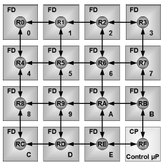
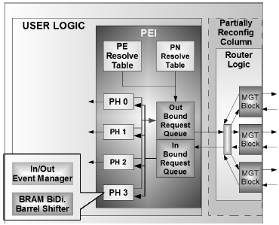
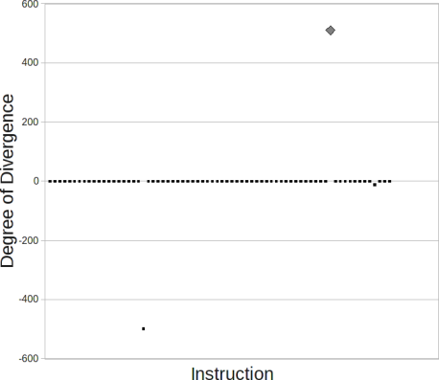
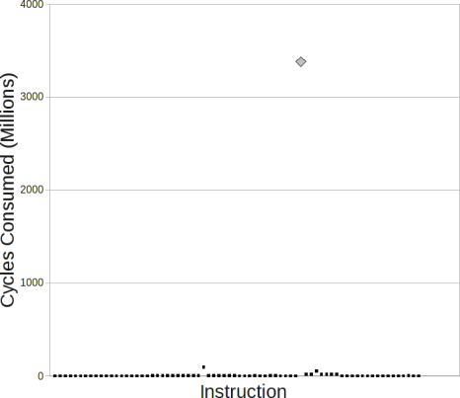
Our Projects
Multi-FPGA System Architectures
Jason D. Bakos, Charles L. Cathey, E. Allen Michalski, "Predictive Load Balancing for Interconnected FPGAs," 16th International Conference on Field Programmable Logic and Applications (FPL'06), Madrid, Spain, August 28-30, 2006.
Charles L. Cathey, Jason D. Bakos, Duncan A. Buell, "A Reconfigurable Distributed Computing Fabric Exploiting Multilevel Parallelism," 14th Annual IEEE International Symposium on Field-Programmable Custom Computing Machines (FCCM'06), April 24-26, 2006.
GPU Simulation
Patrick A. Moran, Jason D. Bakos, "A PTX Simulator for Performance Tuning CUDA Code," IEEE Trans. on Parallel and Distributed Systems, submitted.

Slide 45
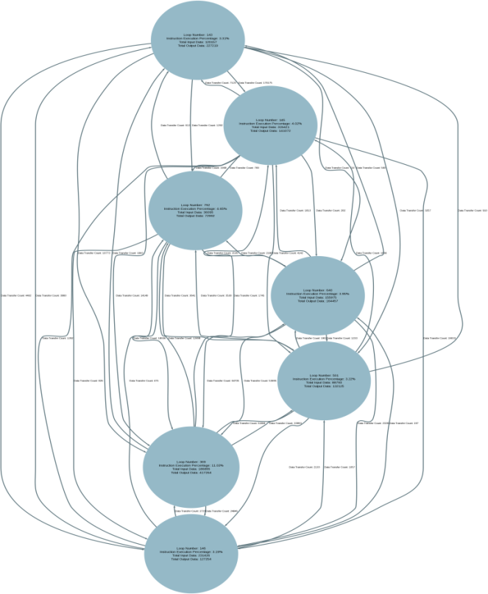
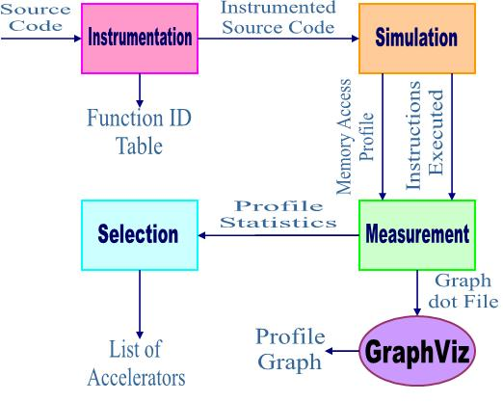
Task Partitioning for Heterogeneous Computing

Slide 46
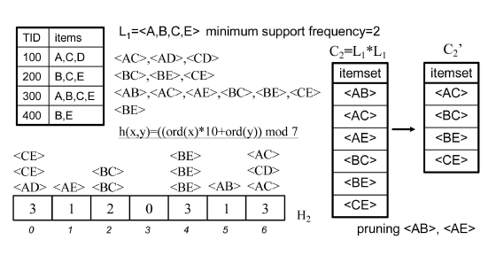
GPU and FPGA Acceleration of Data Mining

Slide 47
Logic Minimization
There are different representations of a Boolean functions
Truth table representation:
F :B³ → Y
Y: ON-Set = {000, 010, 100, 101}
OFF-Set = {011, 110}
DC-Set = {111}
a | b | c | Y
0 | 0 | 0 | 1
0 | 0 | 1 | 1
0 | 1 | 0 | 1
0 | 1 | 1 | 0
1 | 0 | 0 | 1
1 | 0 | 1 | 1
1 | 1 | 0 | 1
1 | 1 | 1 | *

Slide 48
Logic Minimization Heuristics
Looking for a cover for ON-Set. Here is basic steps of the Heuristic Algorithm:
1- P ←{}
2- Select an element from ON-Set {000}
3- Expand {000} to find Primes {a' c' , b'}
4- Select the biggest from the set P ←P U {b'}
5- Find another element in ON-Set which is not covered yet {010} and goto step-2.

Slide 49
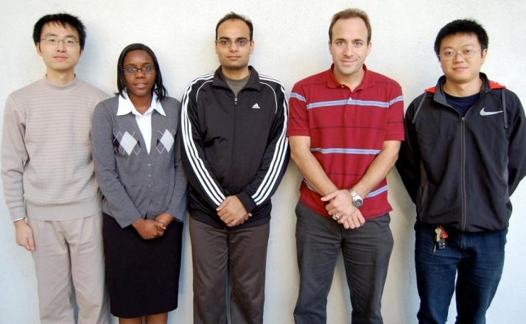
Acknowledgement
Tiffany Mintz
Krishna Nagar
Jason Bakos
Yan Zhang
Zheming Jin
Heterogeneous and Reconfigurable Computing Group
http://herc.cse.sc.edu

